Slide 1



Sixth/Seventh Semester
Essentials of Management
HUM-4001
MBO
Dept. of Humanities and Management,
Manipal Institute of Technology - Manipal

Slide 2

MANAGEMENT BY OBJECTIVES (MBO) :
Following are the common features of the organizational
objectives :
Verifiable and quantified objectives
Hierarchy of objectives
Network of objectives
Multiplicity of objectives
Process of objective setting & organizational hierarchy

Slide 3
MBO Defined :
It is a comprehensive managerial system that integrates many key
managerial activities in a systematic manner and that is consciously
directed toward the effective and efficient achievement of
organizational and individual objectives.
A method whereby managers and employees define
objectives for every department, project, and
person, and use them to monitor subsequent
performance.

Slide 4
MBO emphasizes on the following :
Performance appraisal
Short term objectives and motivation
Long term planning

Slide 5
Process of MBO :
Setting preliminary objectives at the top
Clarifying organizational roles
Setting subordinates objectives
Recycling of objectives

Slide 6
Key result areas: An area in which performance is essential for the success of the enterprise.
Key result areas for business (Peter Drucker)
Market standing
Innovation
Productivity
Physical and financial resources
Profitability
Managerial performance and development
Worker performance and attitude
Public responsibility
Additional Areas:
Service
Quality

Slide 7
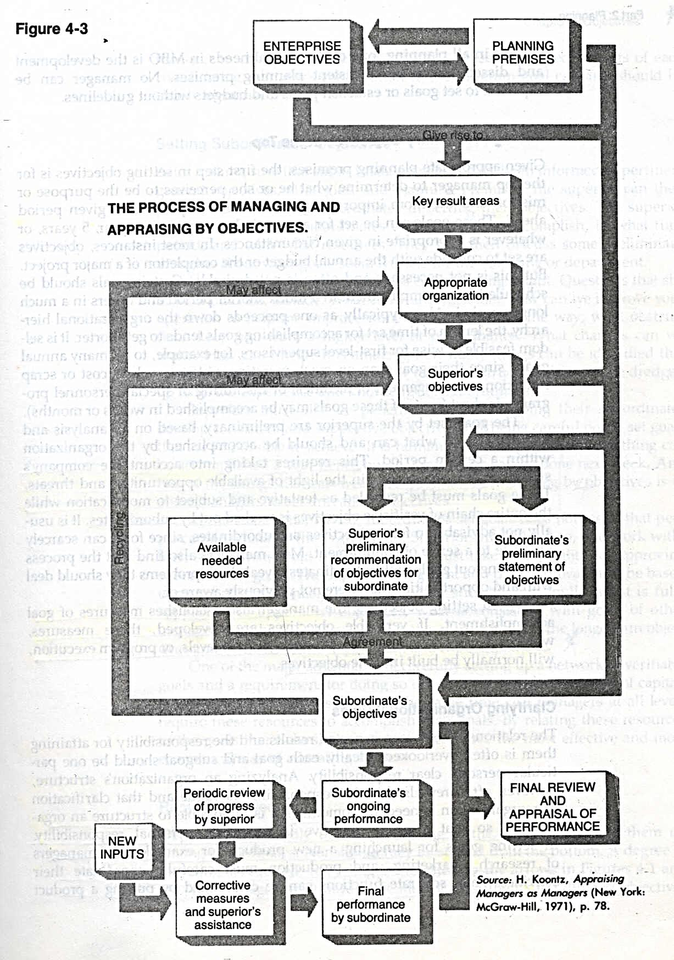

Slide 8
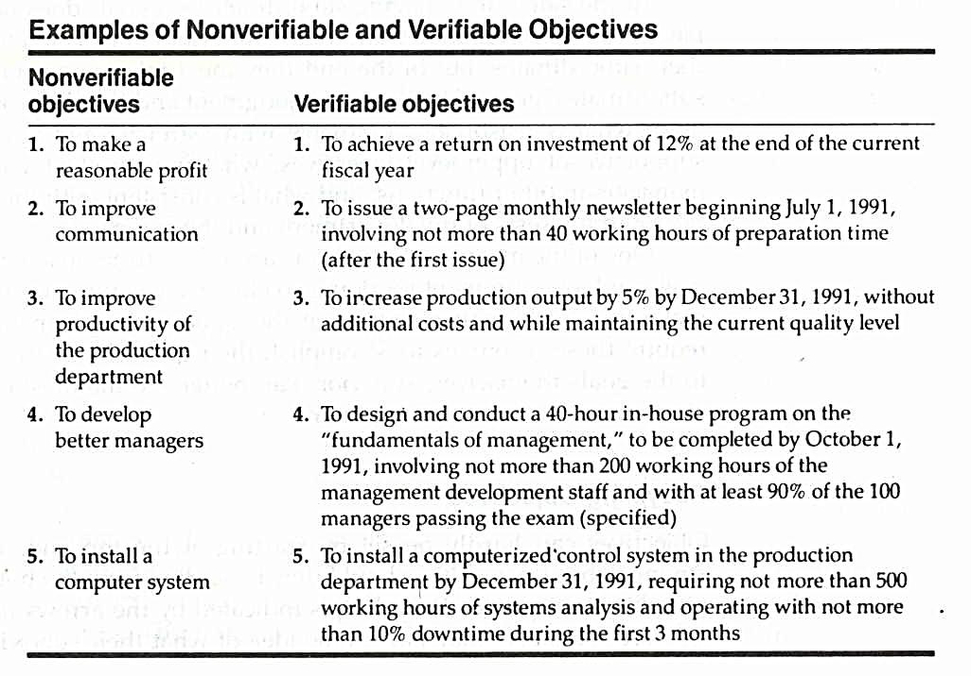
2014
2014
2014
2021

Slide 9
SETTING EMPLOYEE OBJECTIVES
Identify an employee’s key job tasks.
Establish specific and challenging goals for each key task.
Allow the employee to actively participate.
Prioritize goals.
Build in feedback mechanisms to assess goal progress.
Link rewards to goal attainment.

Slide 10
Benefits of MBO
Benefits of MBO
The need for planning will be recognized.
It provides for objectives and accountability for performance.
It encourages participative management.
It helps in job enrichment.
It provides for a good feedback system.

Slide 11
Objectives of MBO
To identify problems and opportunities in business.
To convert identified opportunities into clear goals.
To set up a system to convert these goals into achievements.
To review the organization in the light of the objectives.
To establish the objectives of each job and unit.
To clarify the policies and systems to accomplish the objectives.
To set up a review system.

Slide 12
WEAKNESSES OF “MBO”
Failure to teach the philosophy of MBO
Failure to give guidelines to goal setters
Difficulty of setting goals
Emphasis on short run goals
Danger of inflexibility
Desire to make goals verifiable people may use quantitative goals and attempt to use numbers in areas where they are not applicable.

Slide 13
BENEFITS AND PROBLEMS OF “MBO”
Benefits
Leader/subordinate efforts are focused on activities that will lead to goal attainment
Performance improved up and down the chain
Motivated people
Problems
Change adversely affects planning
Low morale reduces effectiveness
Lower level goals take precedence
Over-centralized authority limits participation
Paperwork

